Slide 1
K8s and F5 BIG-IP DNS Integration – Lab Guide
Chapter 5

Slide 2
Lab Architecture
Management (10.1.1.0/24)
10.1.1.8
10.1.1.4
Client
F5 BIG-IP
LTM+GTM VE
K8s Master
External (10.1.10.0/24)
Internal (10.1.20.0/24)
10.1.10.8
10.1.10.4
10.1.20.4
10.1.20.5
10.1.1.5
K8s Worker1
10.1.20.6
10.1.1.6
K8s Worker2
10.1.20.7
10.1.1.7

Slide 3
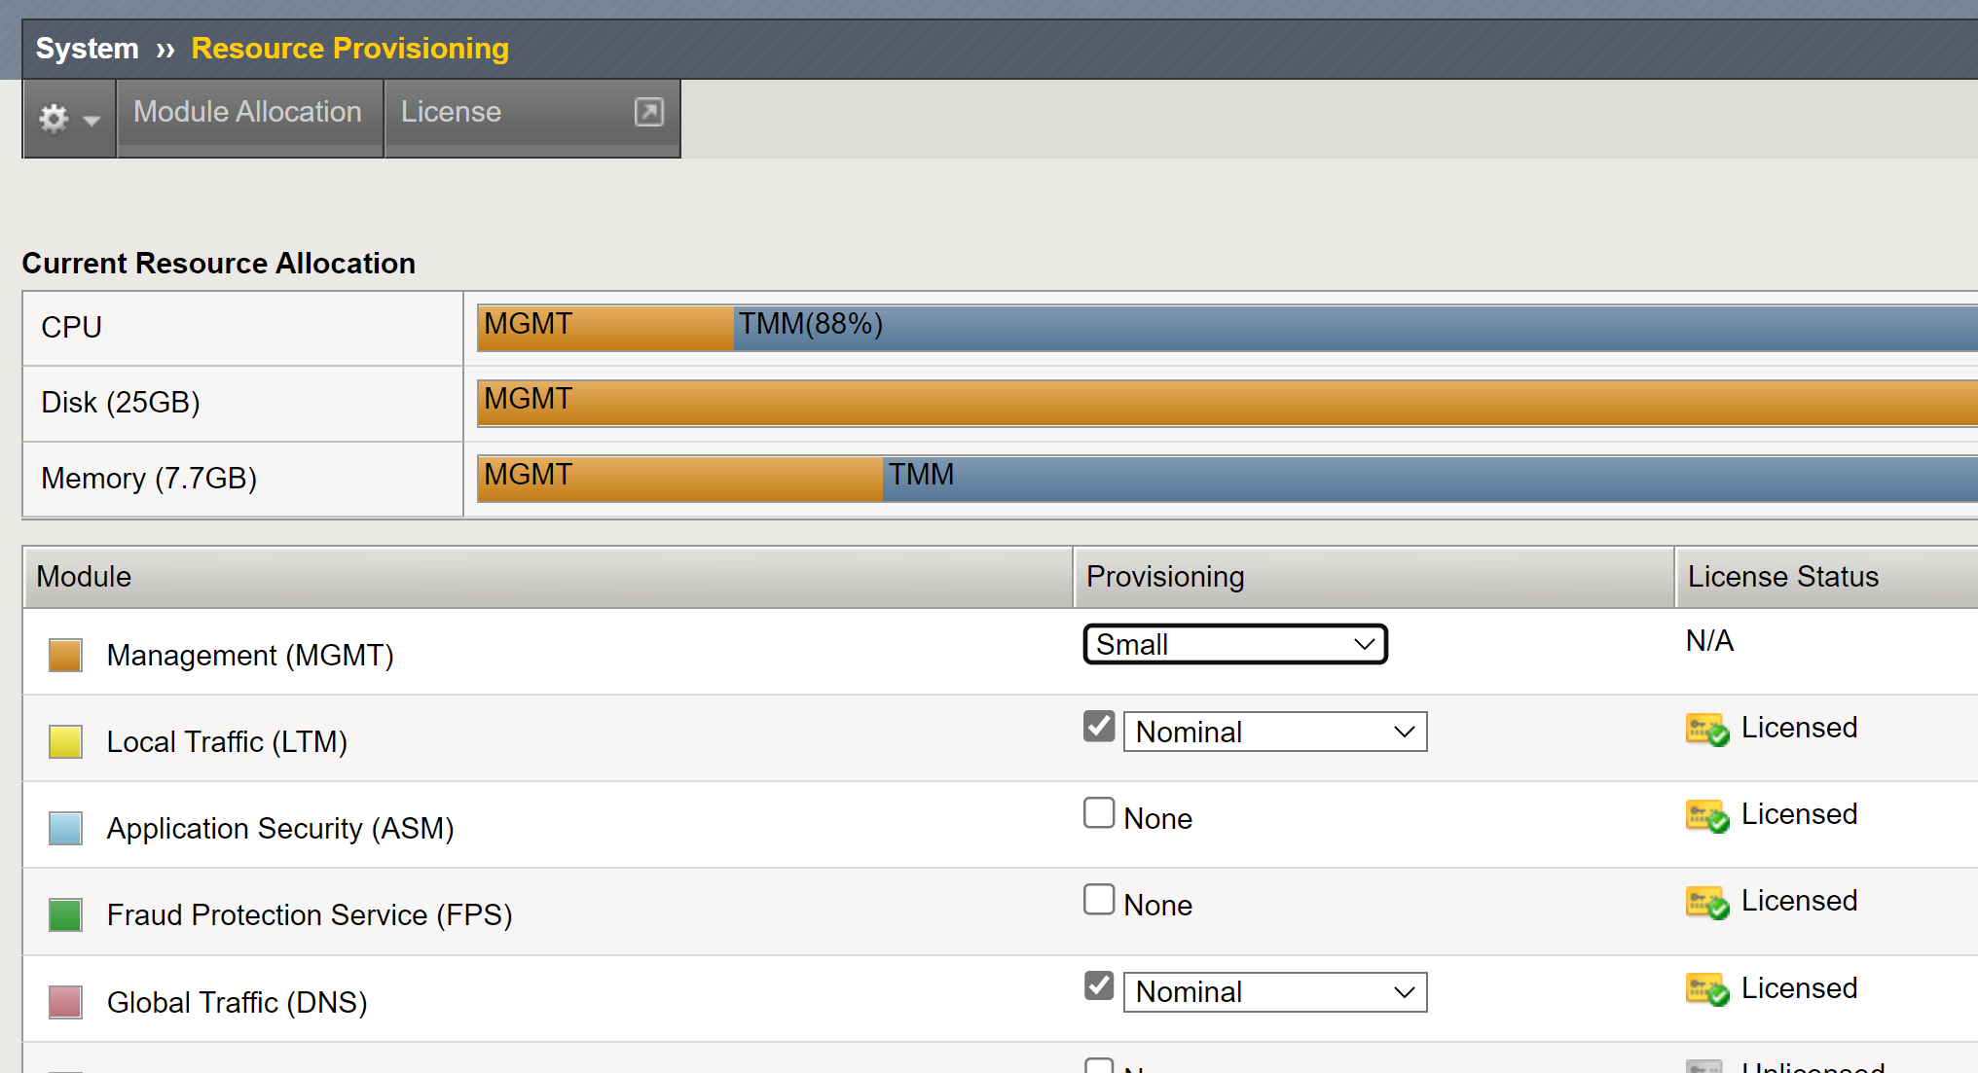
F5 BIG-IP Requirements
Ensure that DNS/GTM is provisioned.

Slide 4
Download YAML Files to Local
Use "git clone" to download the YAML files to local storage inside the client VM and copy all cloned YAML files to the home directory.
git clone https://github.com/jokoyuliantoro/sg-k8s-bootcamp-2022-lab5
cp sg-k8s-bootcamp-2022-lab5/* .

Slide 5
Lab 5 – ExternalDNS

Slide 6
Lab 5 – ExternalDNS
Lab Tasks
5.1) Create a Data Center in F5 GTM
5.2) Update F5 CIS Parameters
5.3) Create ExternalDNS CRD
5.4) Create a DNS Listener in F5 GTM
5.5) Send Test Traffic

Slide 7
Task 5.1) Create a Data Center in F5 GTM

Slide 8
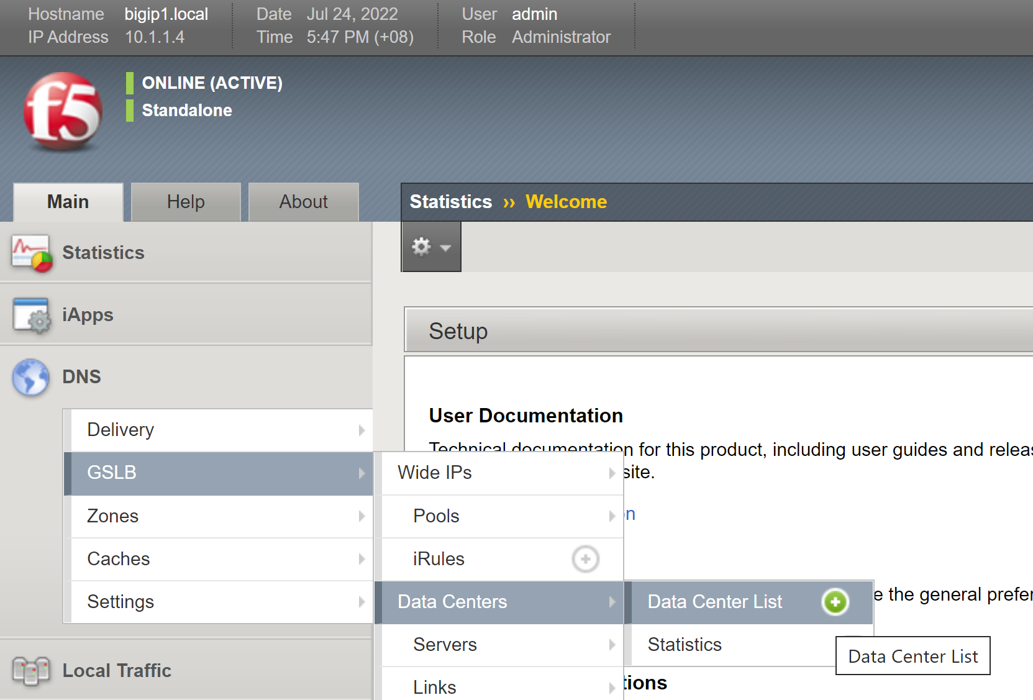
Task 5.1) Create a Data Center in F5 GTM
Bring up the F5 GUI and follow the steps below:

Slide 9
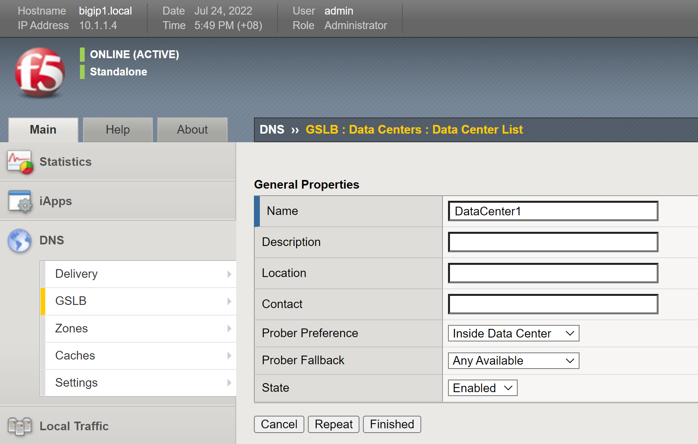
Task 5.1) Create a Data Center in F5 GTM
1
2

Slide 10
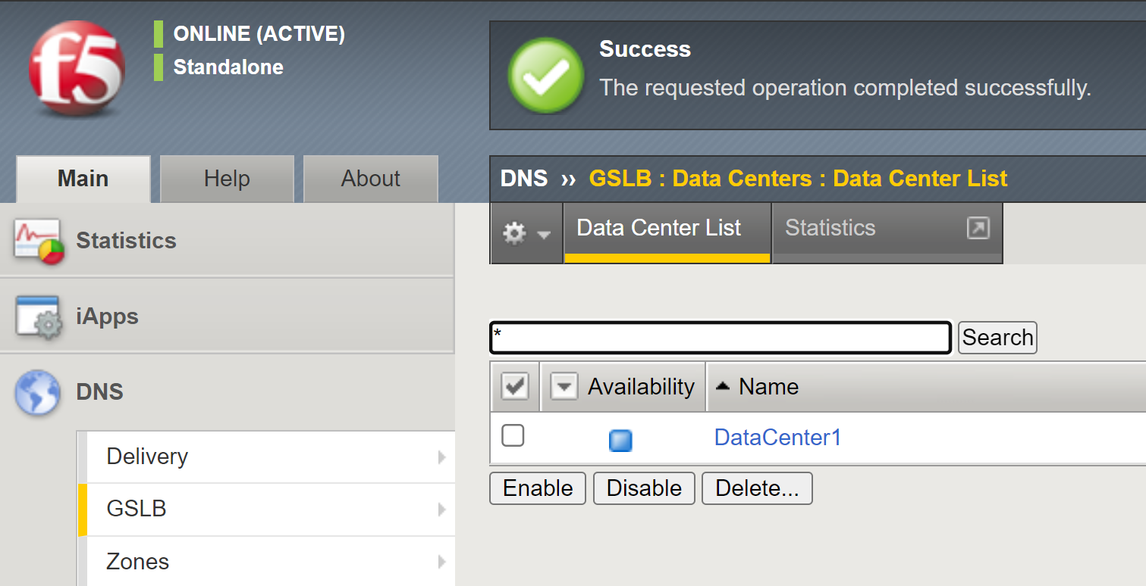

Task 5.1) Create a Data Center in F5 GTM

Slide 11
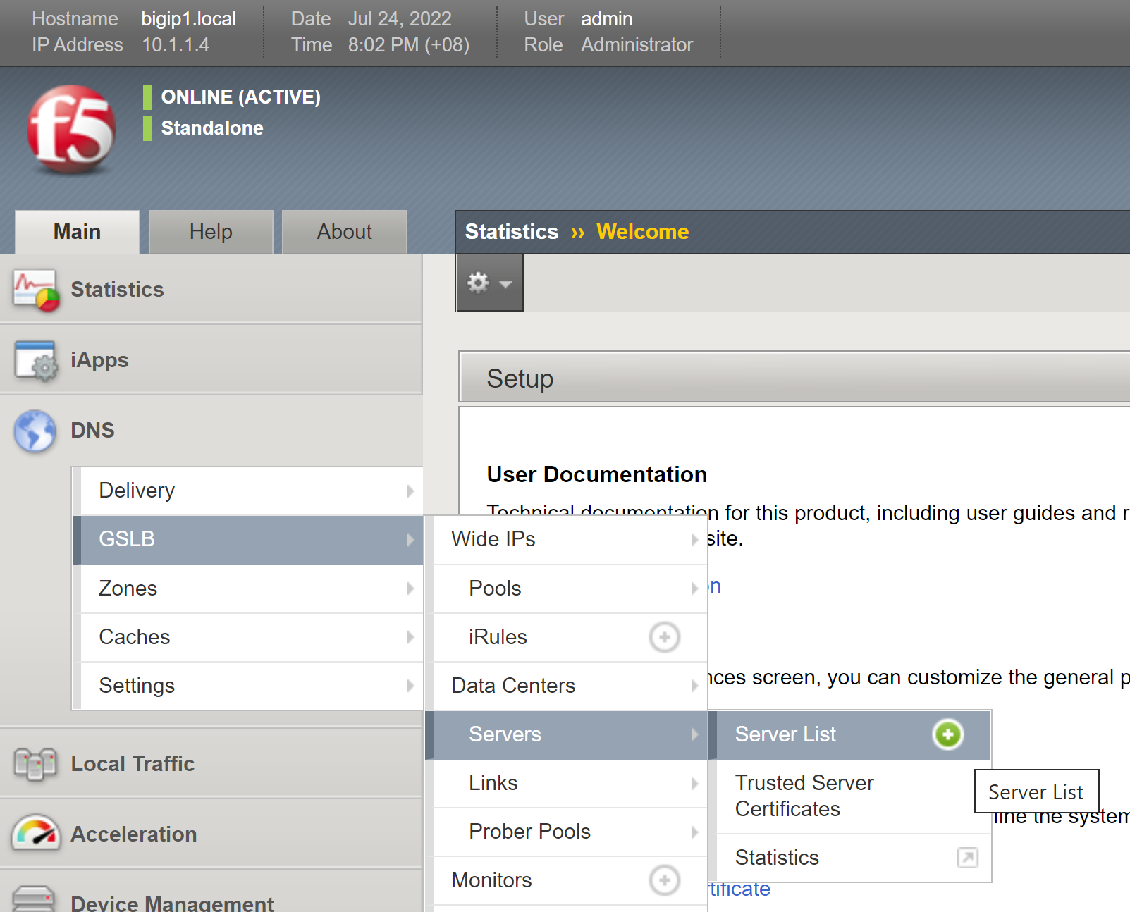
Task 5.1) Create a Data Center in F5 GTM
If not yet, create a server under the create data center that points back to GTM (since this is LTM+GTM).

Slide 12
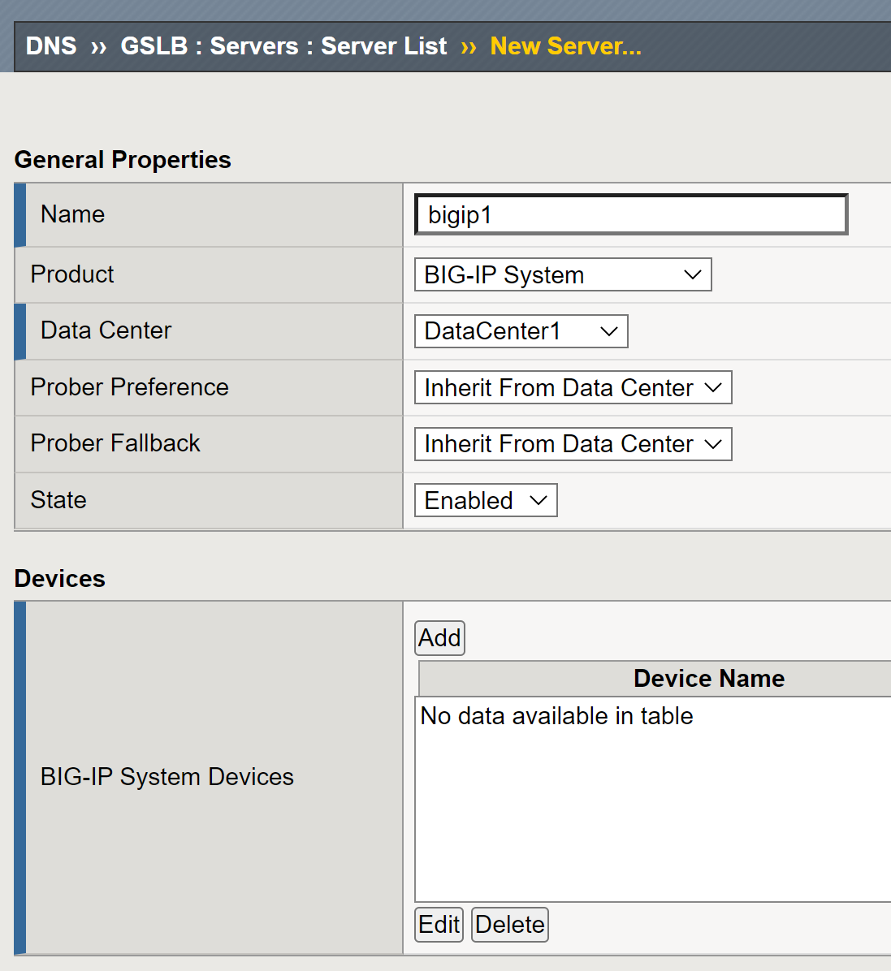
Task 5.1) Create a Data Center in F5 GTM
1
2
3

Slide 13
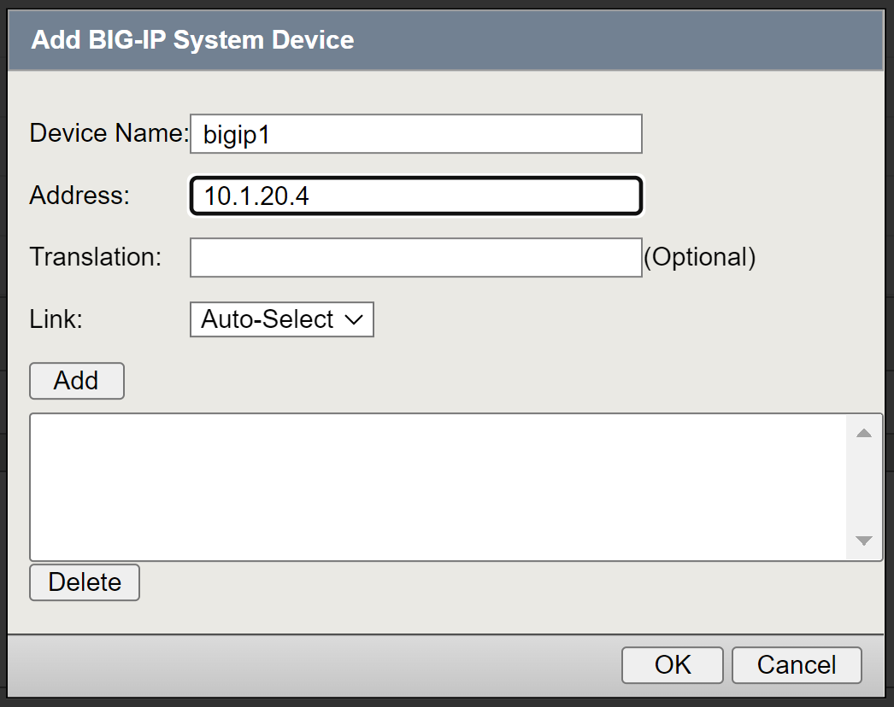
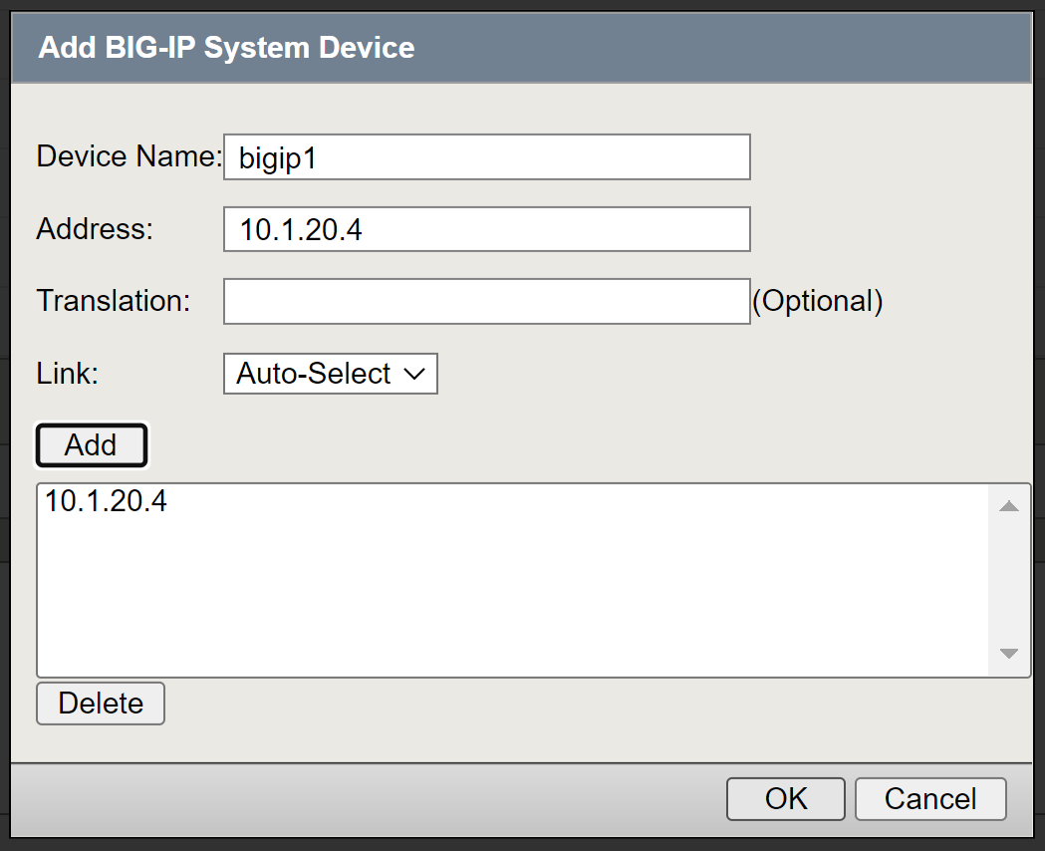
Task 5.1) Create a Data Center in F5 GTM
Enter the Internal self-IP in the Address field.
1
2
3
4

Slide 14
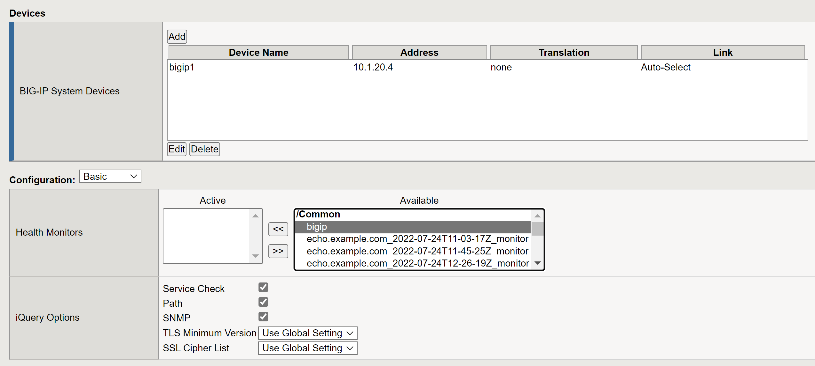
Task 5.1) Create a Data Center in F5 GTM
2
1

Slide 15
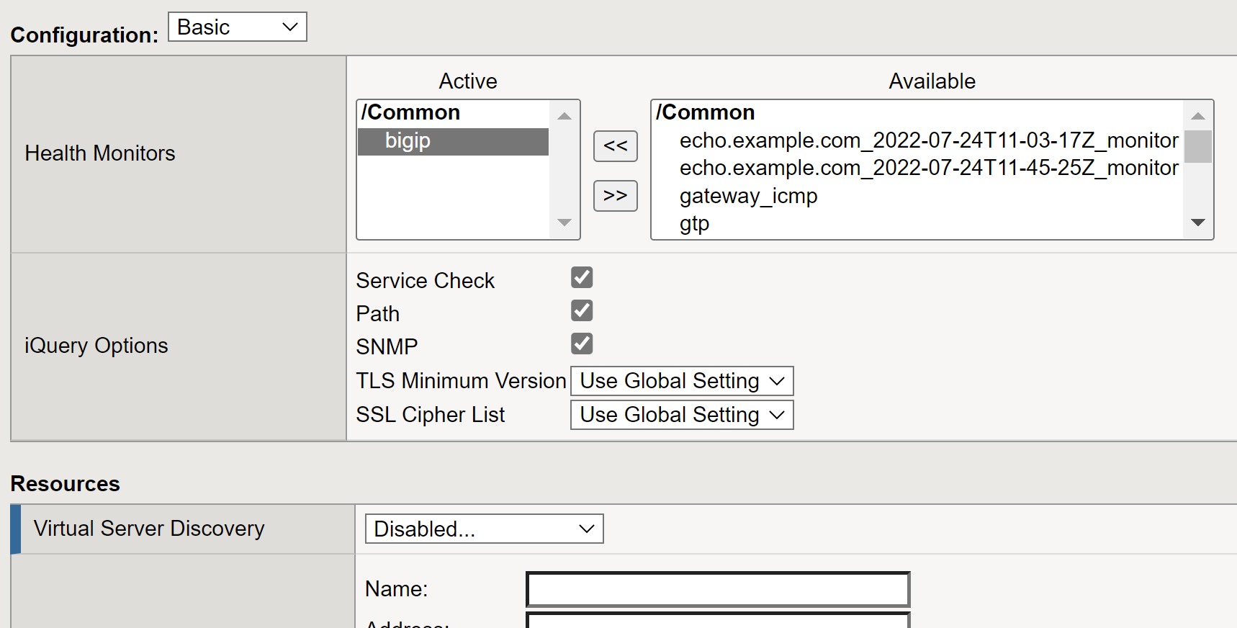
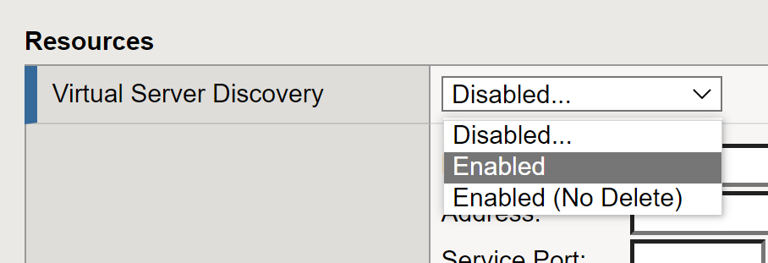
Task 5.1) Create a Data Center in F5 GTM
2
1

Slide 16
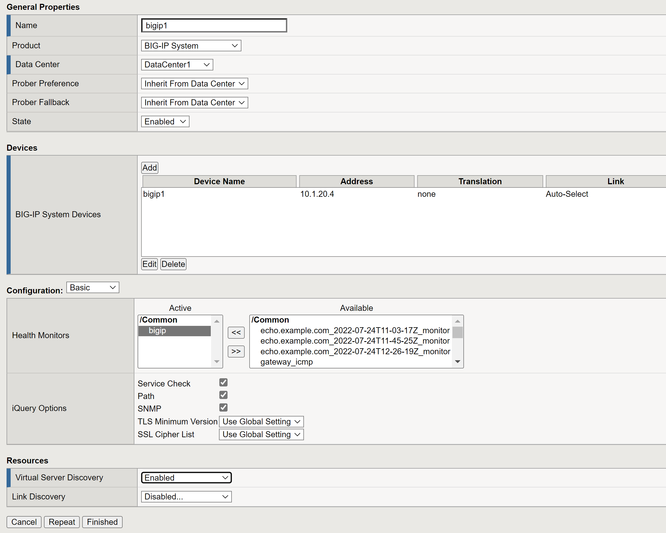
Task 5.1) Create a Data Center in F5 GTM

Slide 17
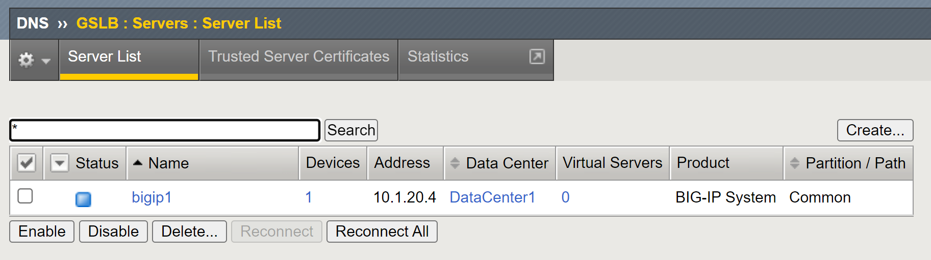
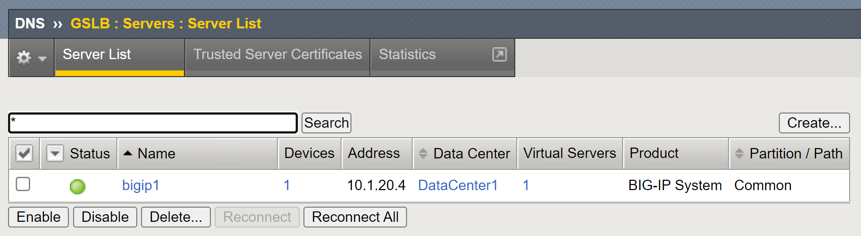
Task 5.1) Create a Data Center in F5 GTM
Refresh the page several times until it shows green status.

Slide 18
Task 5.2) Update F5 CIS Parameters

Slide 19
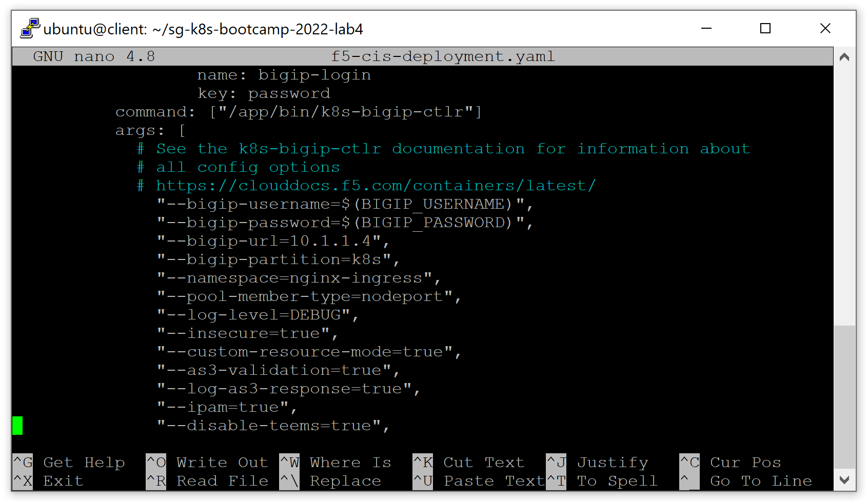
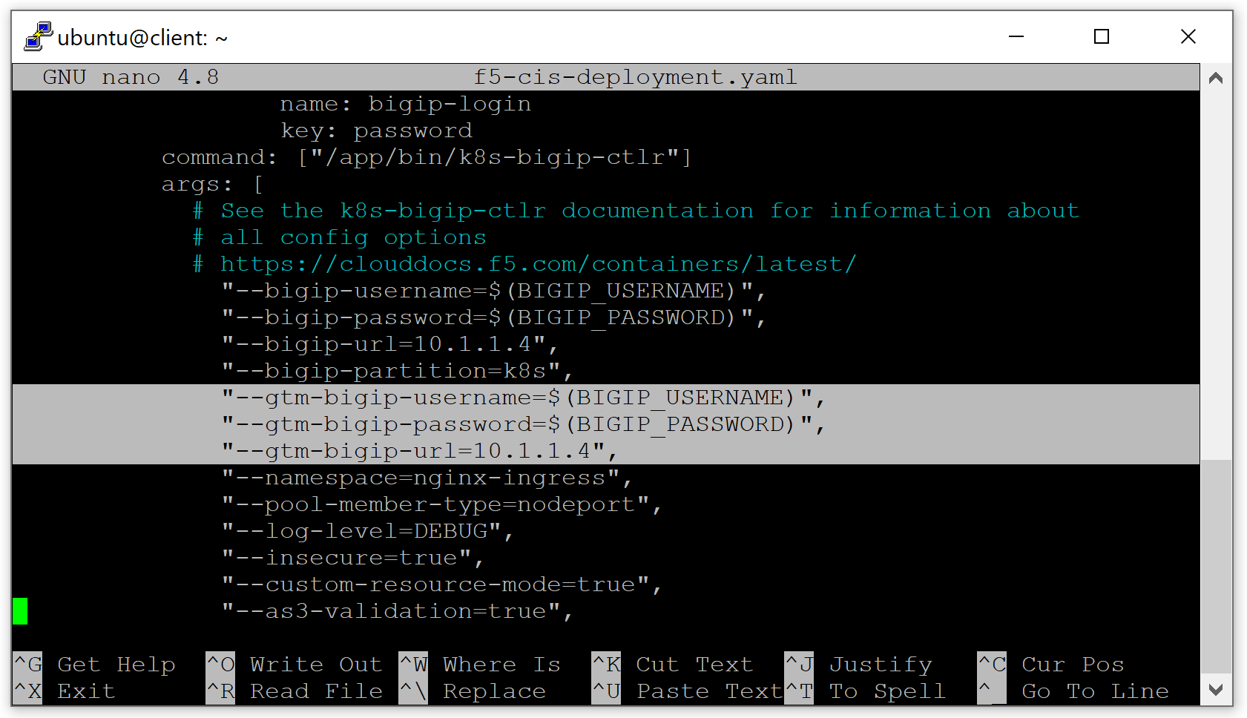
Task 5.2) Update F5 CIS Parameters
Edit the f5-cis-deployment.yaml file using your favorite editor. Add the below 3 lines into the arguments list of the CIS software:
"--gtm-bigip-username=$(BIGIP_USERNAME)",
"--gtm-bigip-password=$(BIGIP_PASSWORD)",
"--gtm-bigip-url=10.1.1.4",

Slide 20
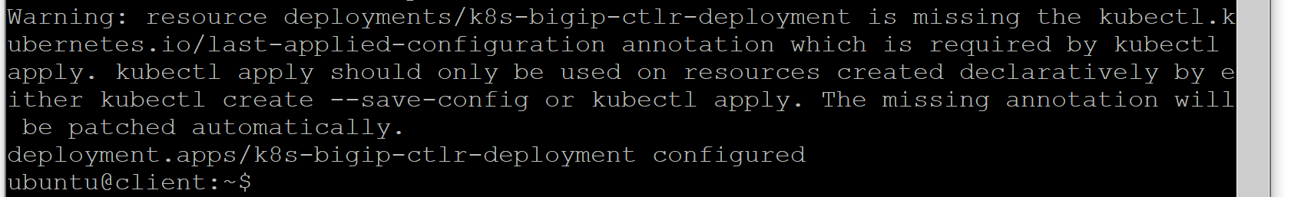
Task 5.2) Update F5 CIS Parameters
Apply the change to the F5 CIS deployment.
kubectl apply -f f5-cis-deployment.yaml
Ignore the warning.

Slide 21
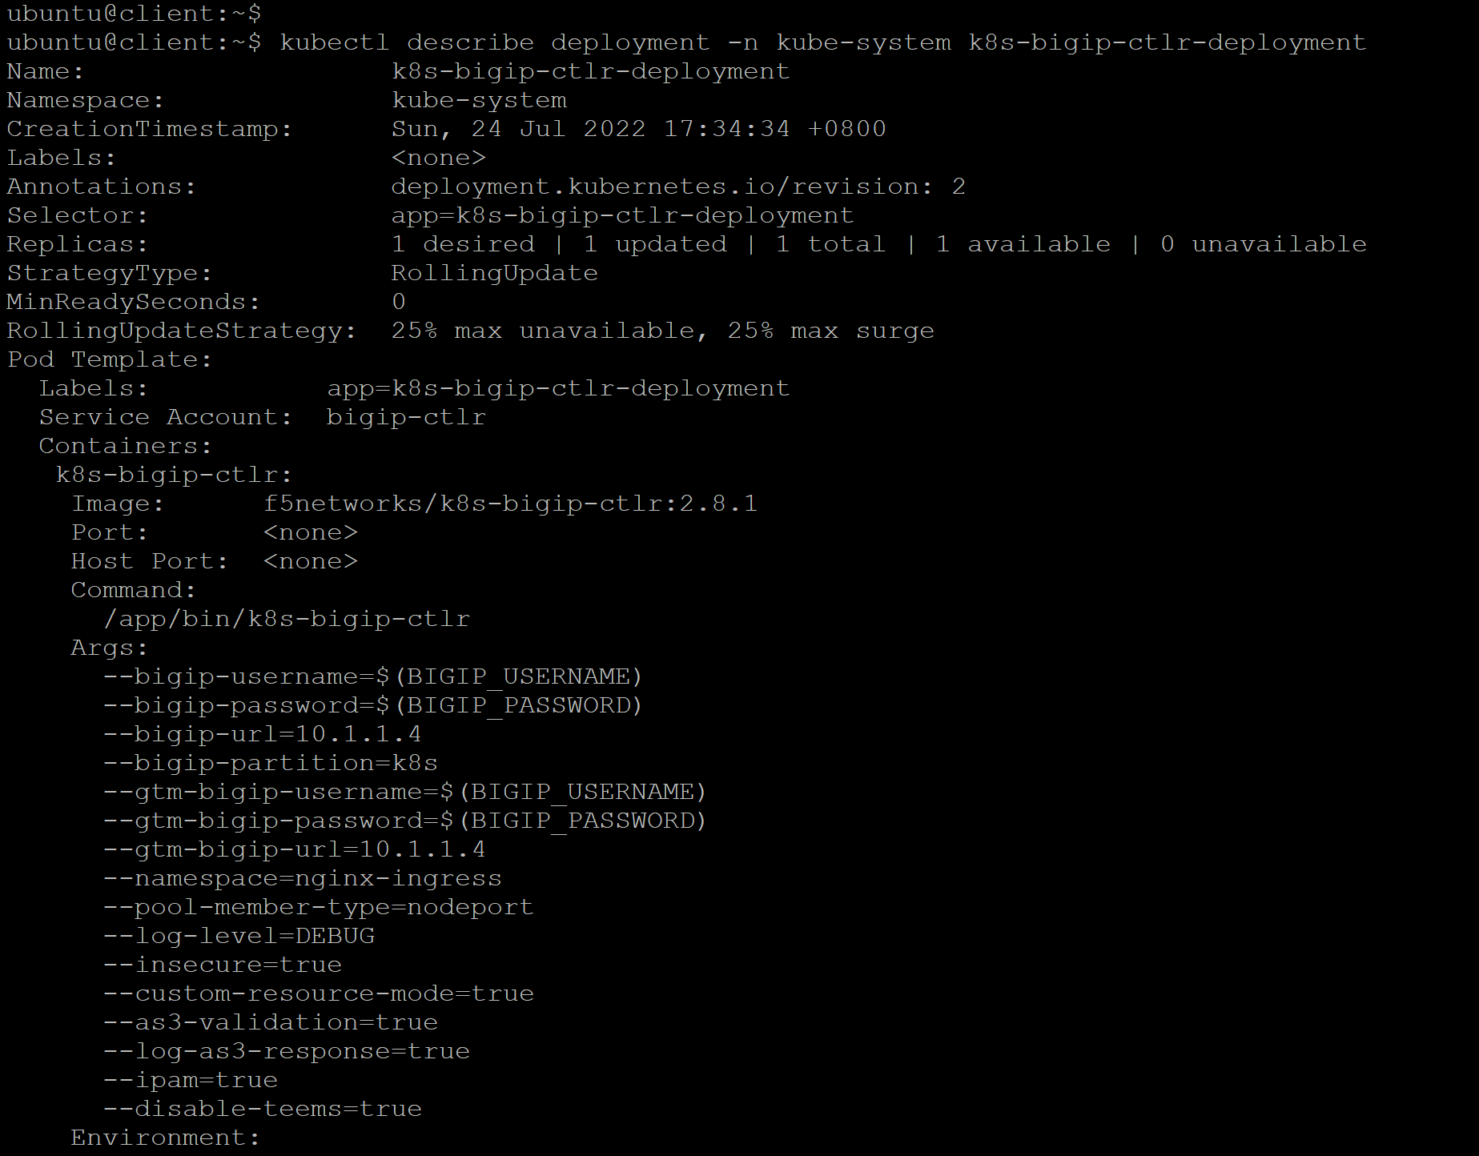
Task 5.2) Update F5 CIS Parameters
Verify the 3 lines added to the arguments.
kubectl describe deployment -n kube-system k8s-bigip-ctlr-deployment

Slide 22
Task 5.3) Create ExternalDNS CRD

Slide 23
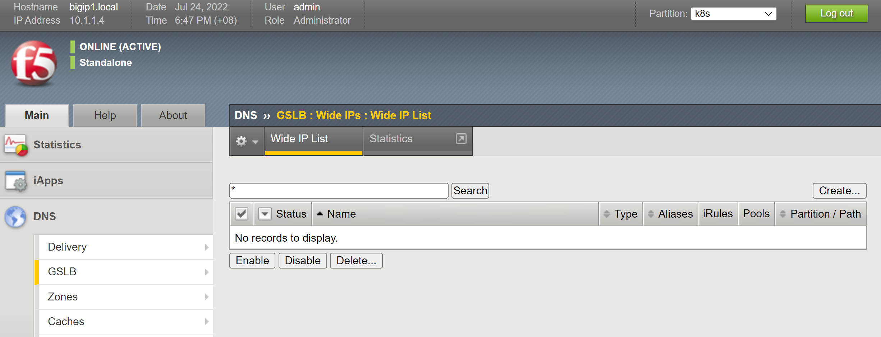
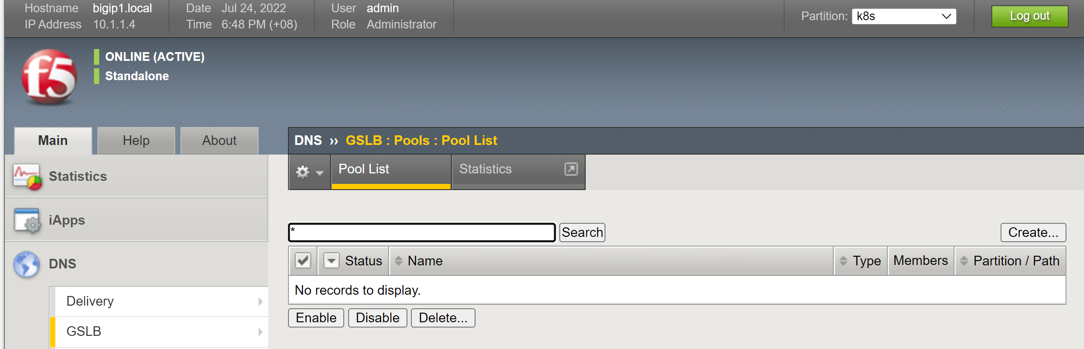
Task 5.3) Create ExternalDNS CRD
Examine the GTM configuration section that there is no WideIP and GTM pool configured.

Slide 24
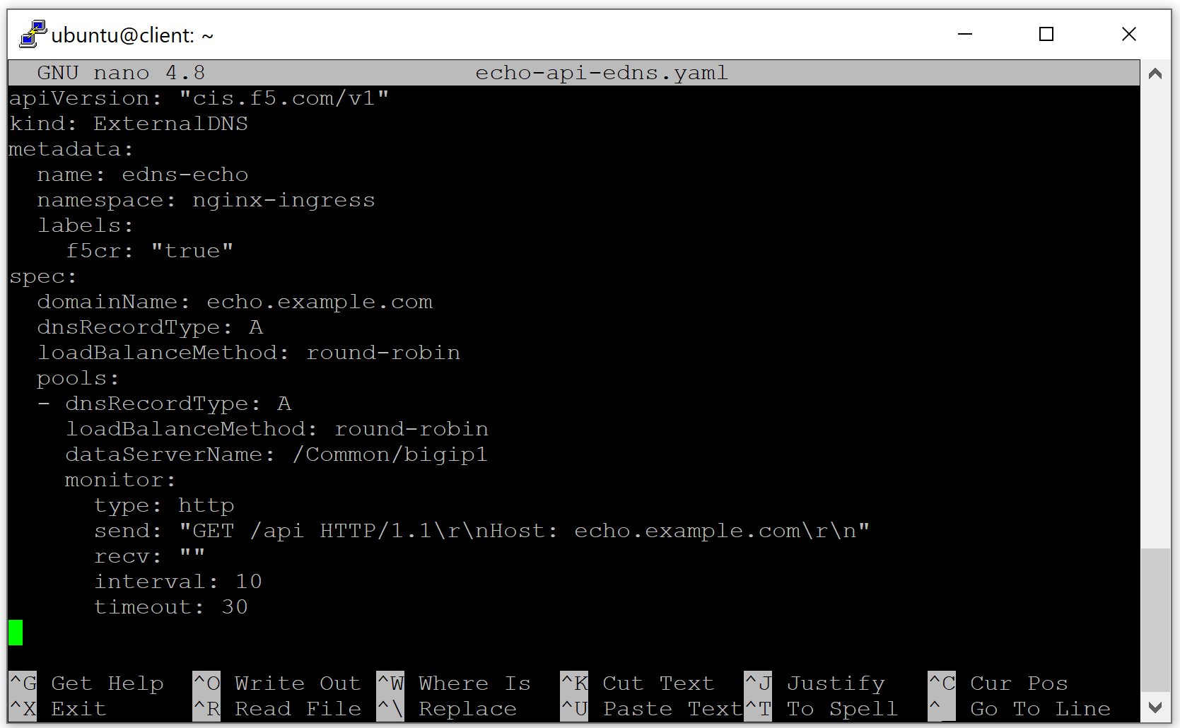
Task 5.3) Create ExternalDNS CRD
Examine the echo-api-edns.yaml file with your favorite.

Slide 25
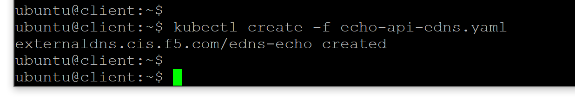
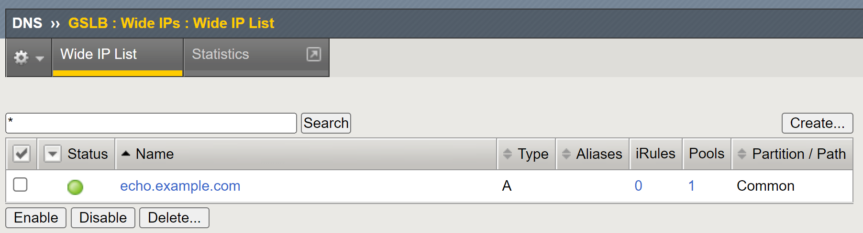
Task 5.3) Create ExternalDNS CRD
Create the ExternalDNS CRD.
kubectl create -f echo-api-edns.yaml

Slide 26
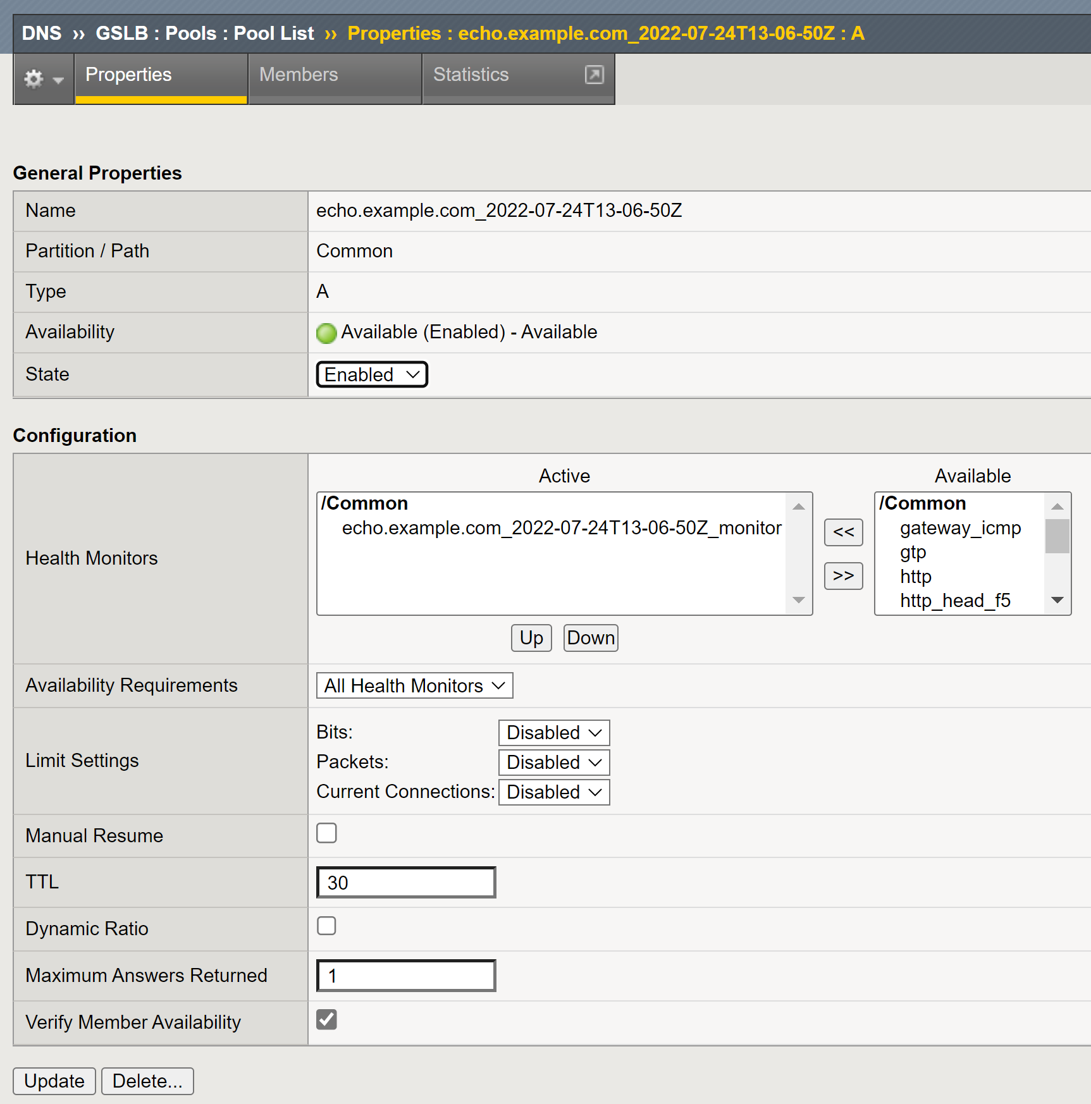
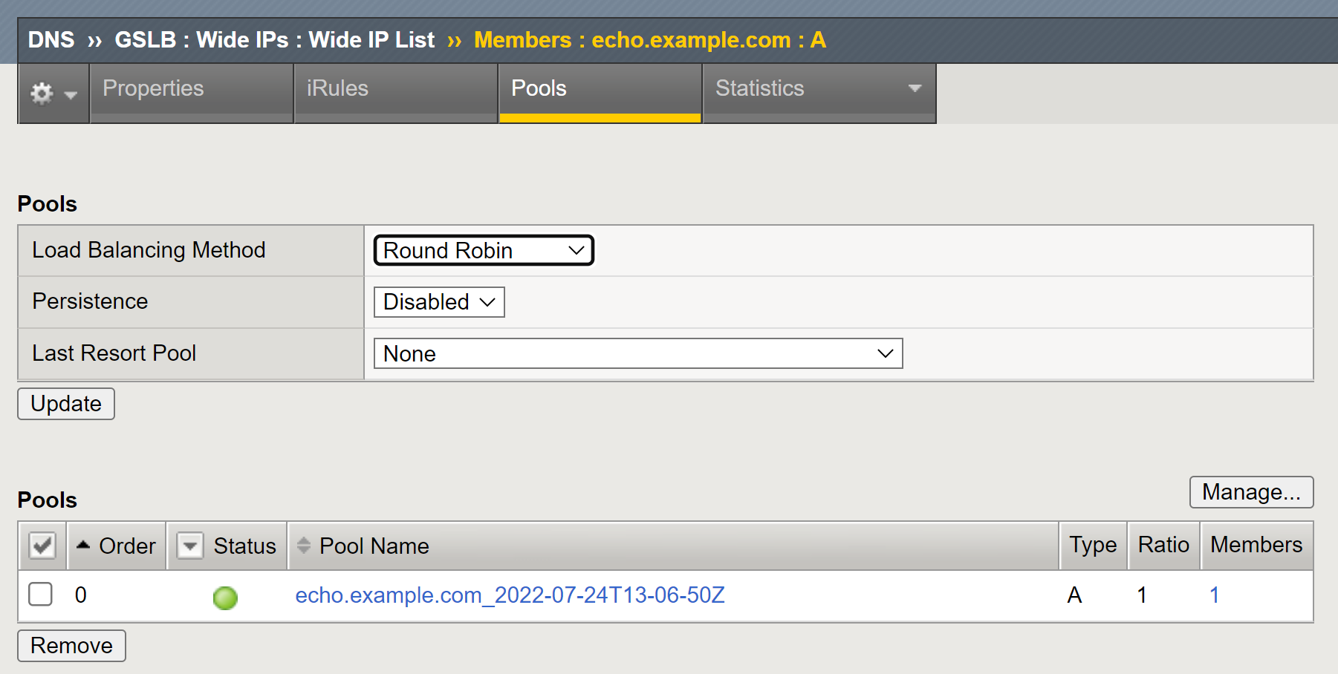
Task 5.3) Create ExternalDNS CRD
The objects are automatically created by ExternalDNS.

Slide 27
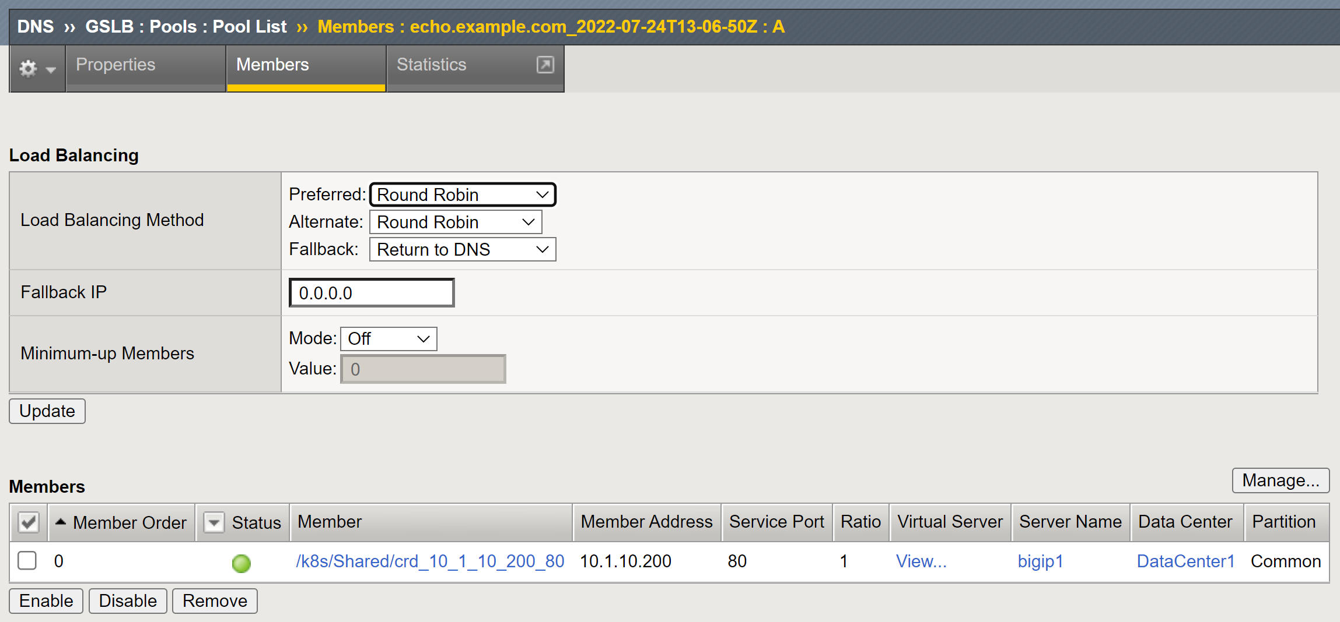
Task 5.3) Create ExternalDNS CRD

Slide 28
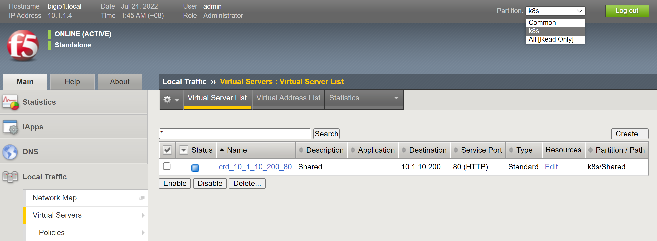
Task 5.3) Create ExternalDNS CRD

Slide 29
Task 5.4) Create a DNS Listener in F5 GTM

Slide 30
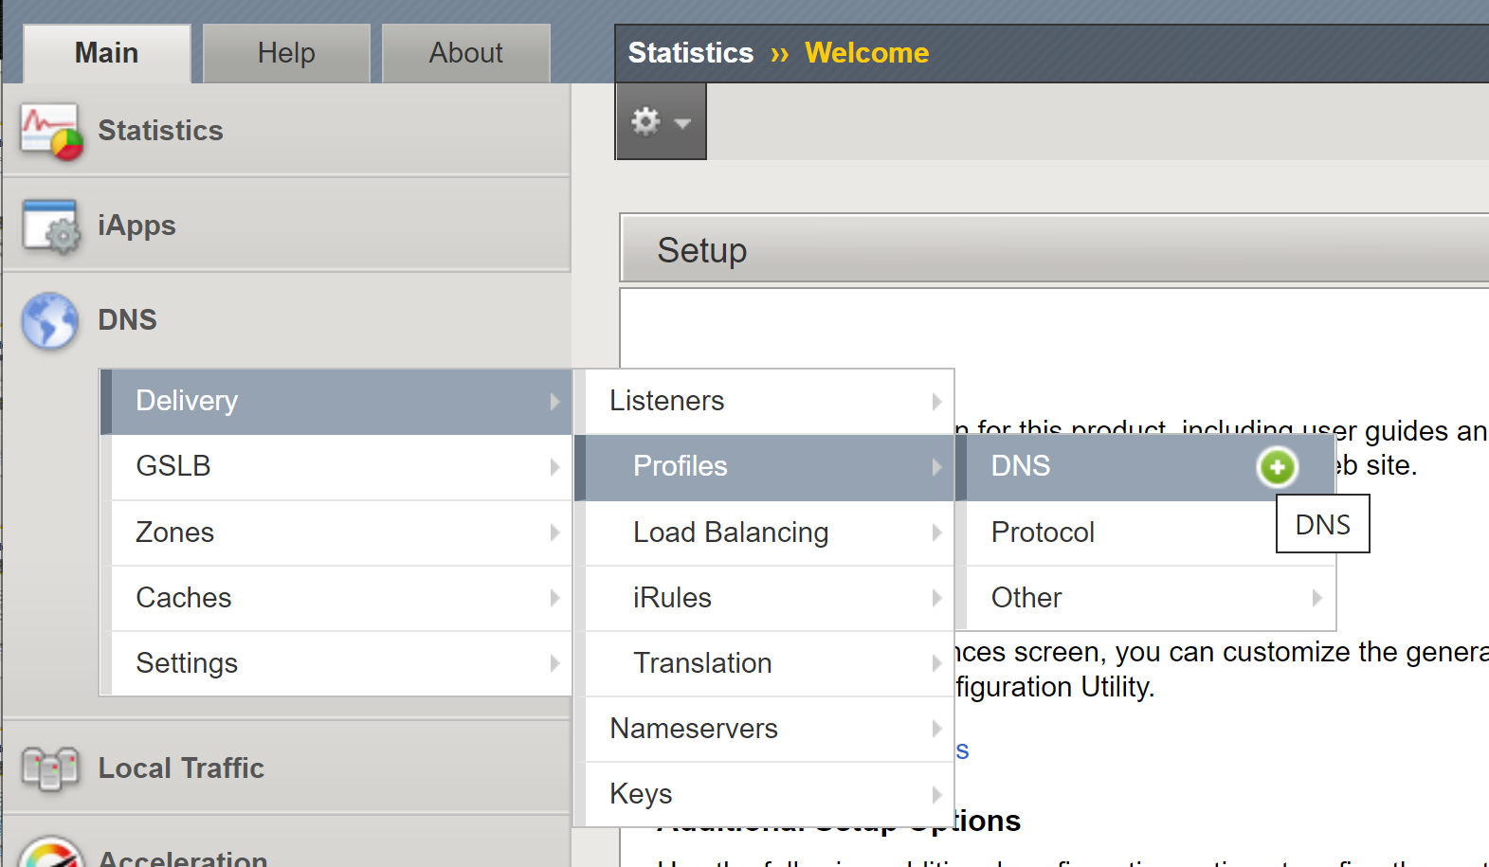
Task 5.4) Create a DNS Listener in F5 GTM

Slide 31
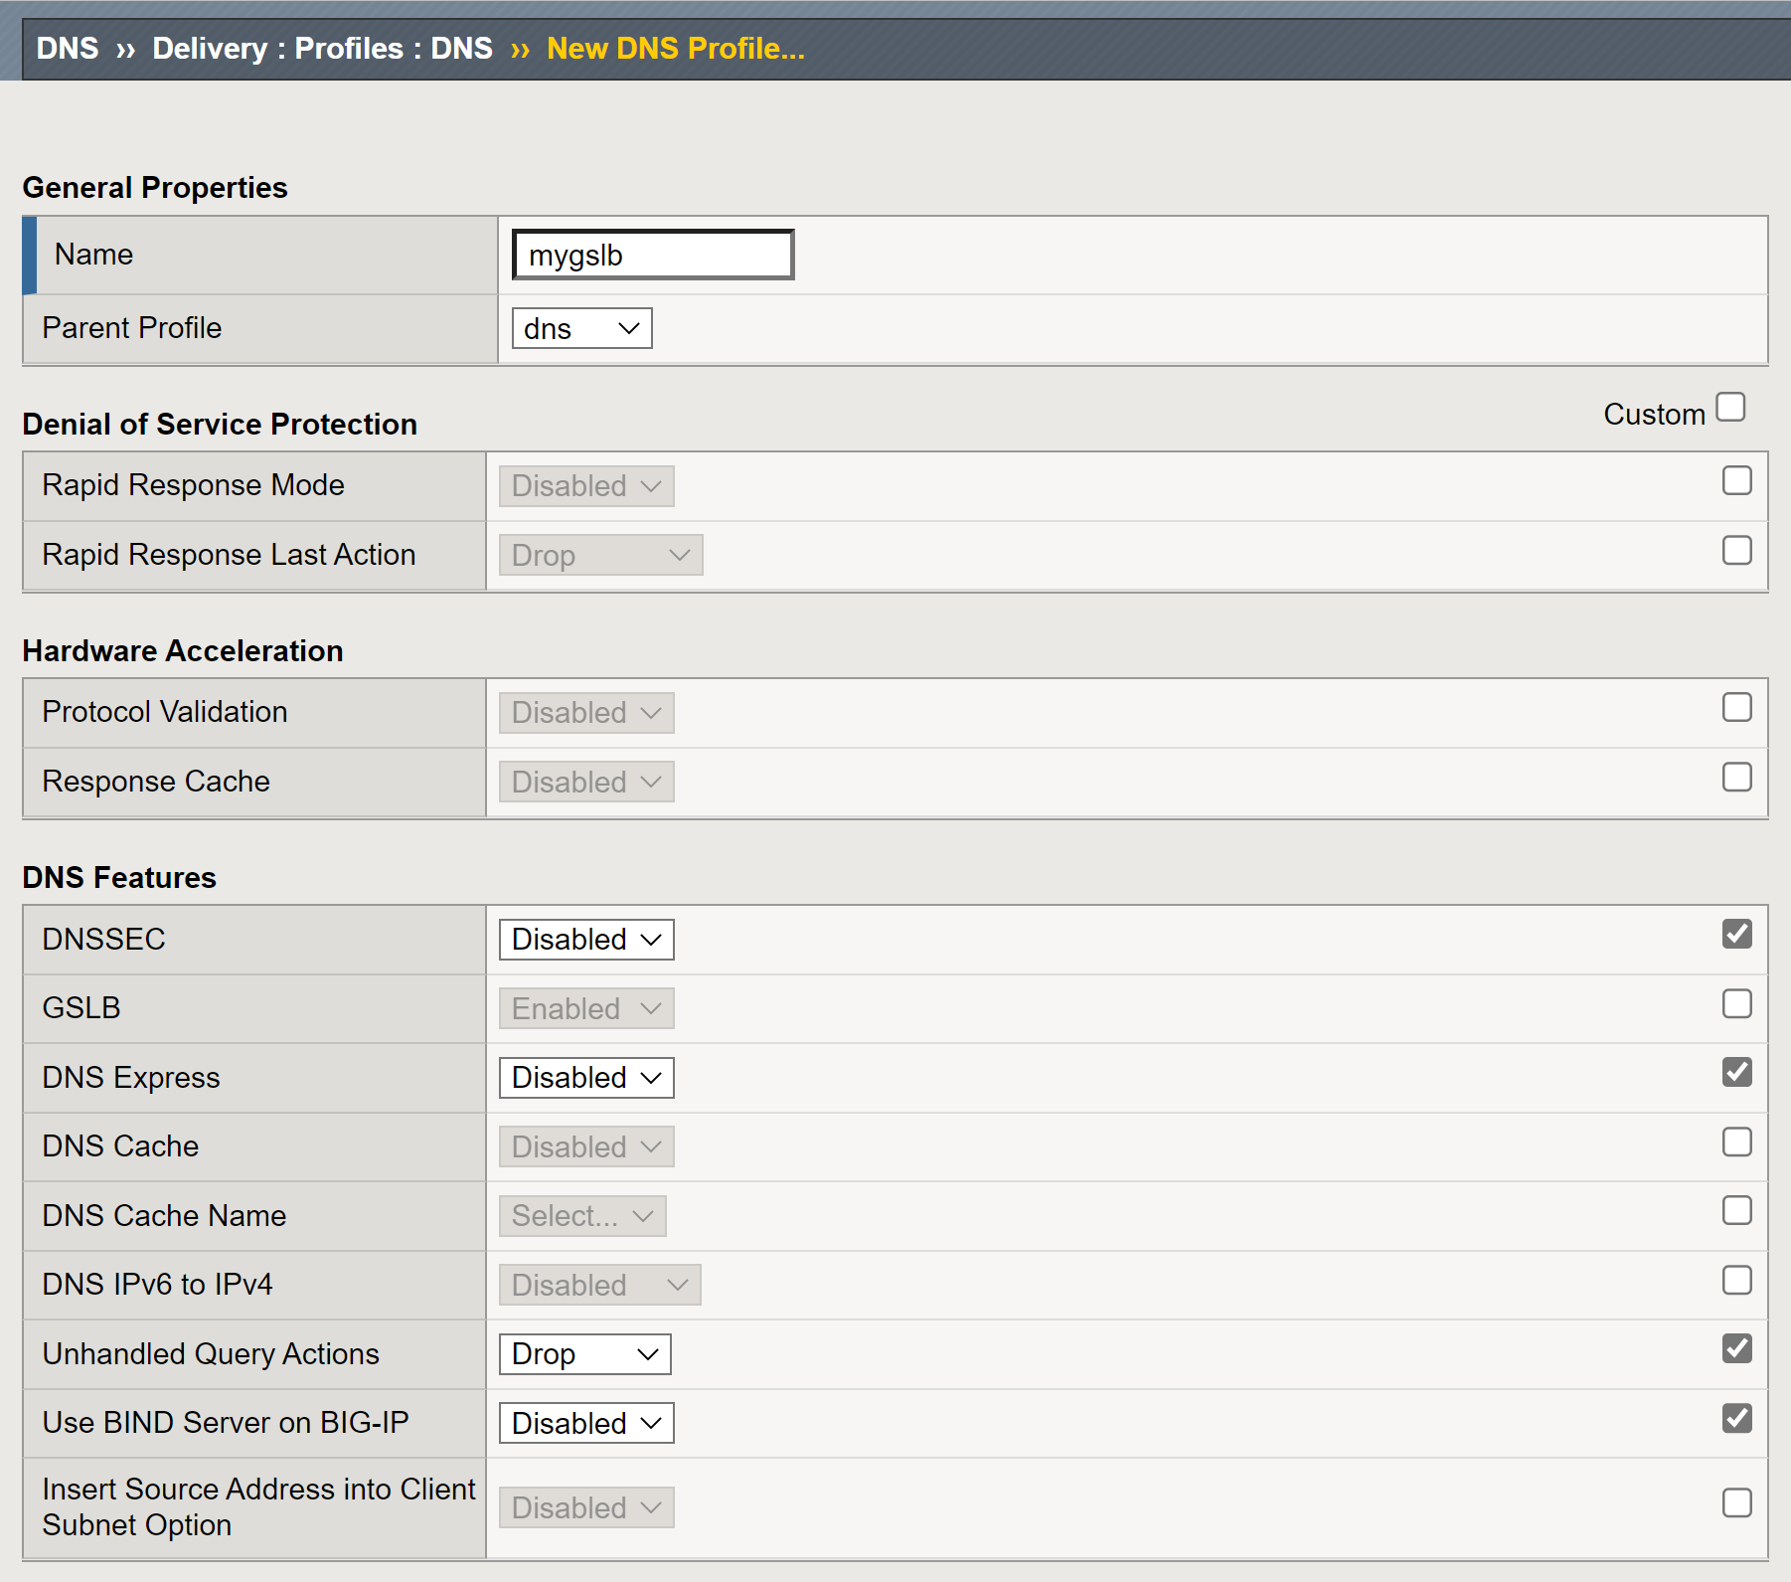
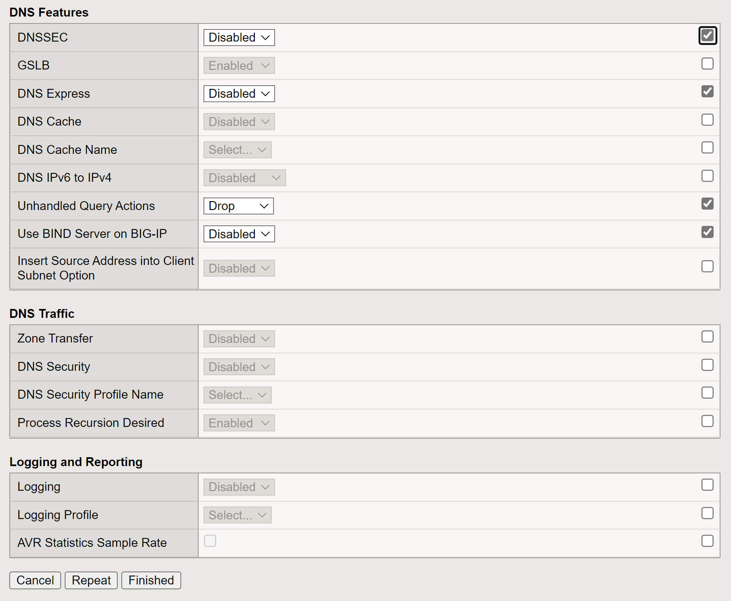
Task 5.4) Create a DNS Listener in F5 GTM
1
2
3
4
5
6

Slide 32
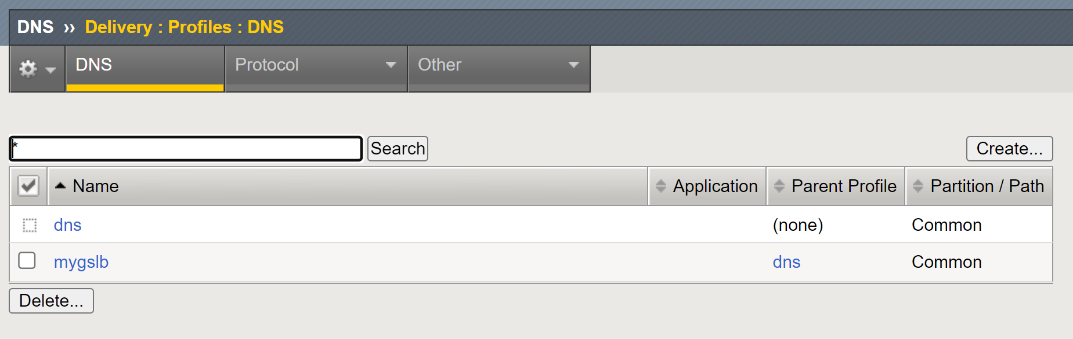
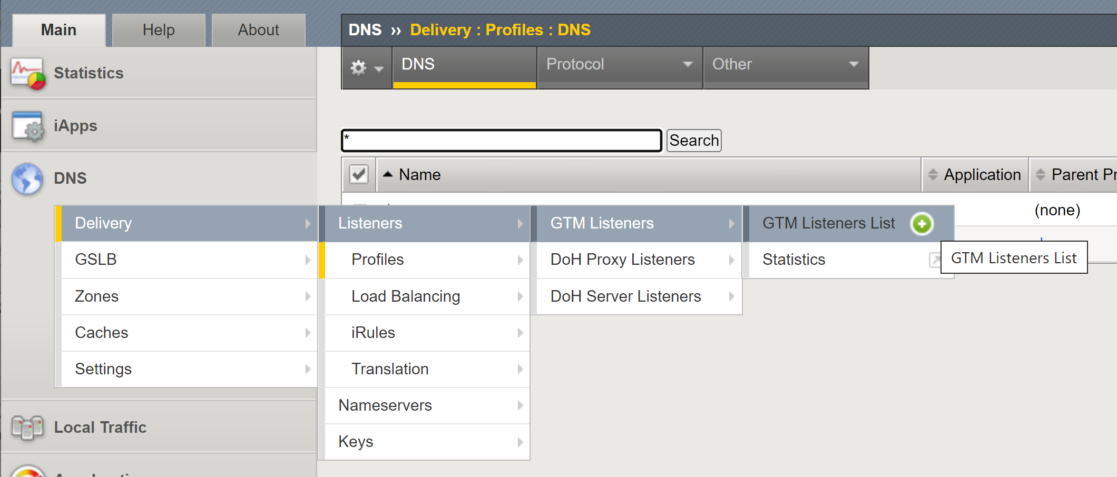
Task 5.4) Create a DNS Listener in F5 GTM

Slide 33
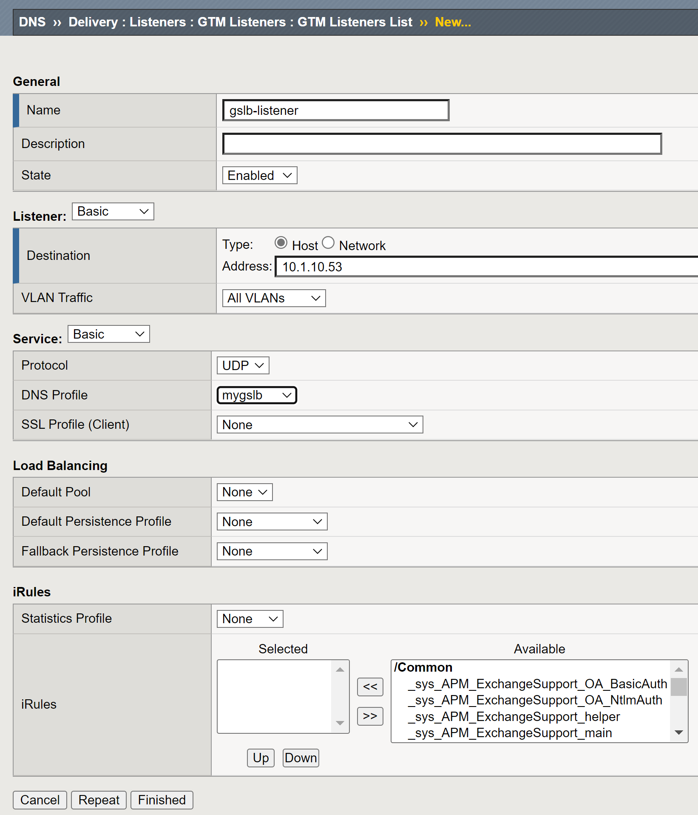
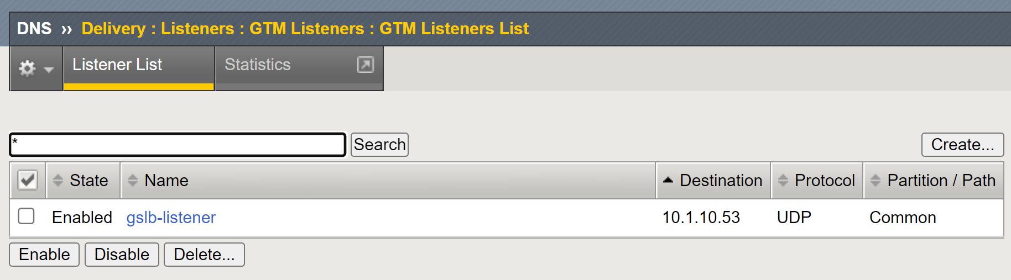
Task 5.4) Create a DNS Listener in F5 GTM
1
2
3

Slide 34
Task 5.5) Send Test Traffic

Slide 35
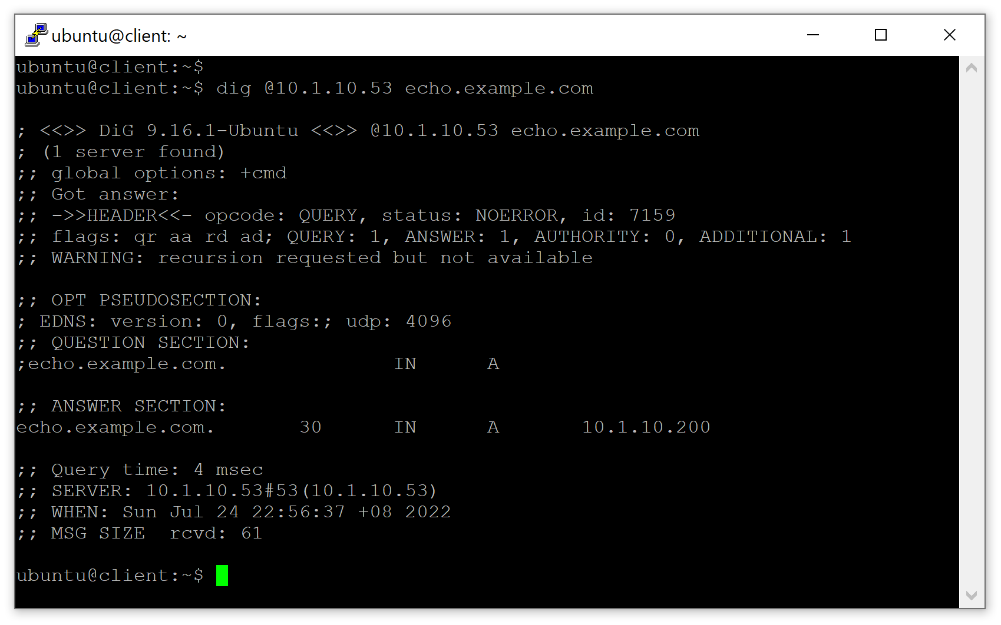
Task 5.5) Send Test Traffic and Inspect It

Slide 36
Summary

Slide 37
What We Have Learned in This Chapter
Understand the need of DNS management in K8s.
Automate the GSLB configuration in F5 from K8s using F5 CIS ExternalDNS module.

